Slide 1
Ultra-Short Introduction to Computer Graphics and Visualisation
ACSE-5: Lecture 10
Adriana Paluszny
Royal Society University Research Fellow

Slide 2
Computer Graphics
Data
Performance/Speed
Cost (GPU/CPU)
Realism
Reconstructing 2D from 3D and vice versa

Slide 3
From ‘processing’ to ‘displaying’
Overview of Computer Graphics Hardware, https://www.ntu.edu.sg/

Slide 4
More Data – More Memory Access
In advanced programming for graphics you must be aware of memory hierarchy

Slide 5
Schematic
In advanced programming for graphics you must be aware of ‘3D’ space vs a ’2D’ screen
Display
Model
Image
interaction
User

Slide 6
Also…
Computer
Graphics
Model
Image
Pattern
Recognition
Image
Processing

Slide 7
From model to image
Normalised Device Coordinates
Model
World
View
NDC
Display
Graphics pipeline
Coordinates and transformations
http://www.real3dtutorials.com

Slide 8
Rendering ‘Pipeline’

Slide 9
Generating graphics
Special-purpose programs
Photoshop, Powerpoint, AutoCAD, StudioMax, Maya, Blender, PovRay, …
General graphics libraries and standards
Windows API, OpenGL, Direct3D, WebGL, Vulkan
Visualisation Libraries
VTK (Visualisation Toolkit), Insight Segmentation and Registration Toolkit (ITK)

Slide 10
CG standards
Set of graphics functions, to be called from programming language
Access to and abstract from hardware
Standardization
C, C++, Java, Delphi,…
CG API
Fortran, Pascal, …
Drivers
Display
Input dev.
Display
Input dev.
1975
2000

Slide 11
Functions
Graphics Output Primitives
Line, polygon, sphere, …
Attributes
Color, line width, texture, …
Geometric transformations
Modeling, Viewing
Shading and illumination
Input functions

Slide 12
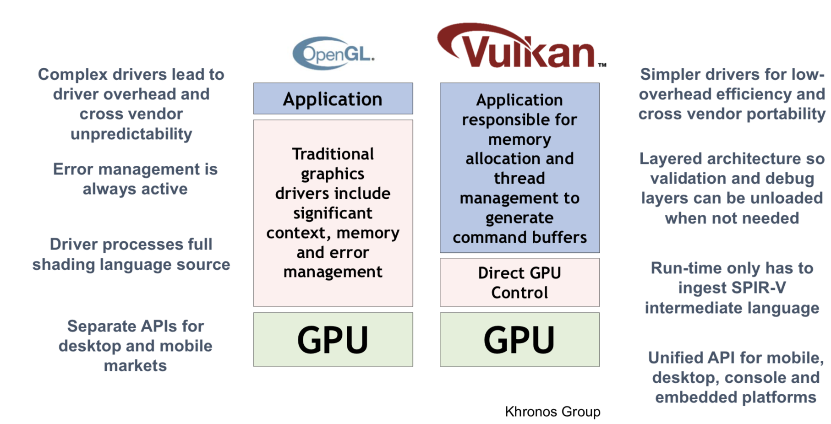
Software standards
GKS, PHIGS, PHIGS+ (1980-)
GL (Graphics Library, SGI)
OpenGL (early 1990s)
Direct3D (MS), Java3D, VRML,…
WebGL
Vulkan

Slide 13
What Is OpenGL?
Graphics rendering API
high-quality color images composed of geometric and image primitives
window system independent
operating system independent
Notes:
OpenGL is a library for doing computer graphics. By using it, you can create interactive applications which render high-quality color images composed of 3D geometric objects and images.
OpenGL is window and operating system independent. As such, the part of your application which does rendering is platform independent. However, in order for OpenGL to be able to render, it needs a window to draw into. Generally, this is controlled by the windowing system on whatever platform you’re working on.

Slide 14
OpenGL Architecture
Per Vertex
Operations &
Primitive
Assembly
Polynomial
Evaluator
CPU
Display List
Rasterization
Per Fragment
Operations
Frame
Buffer
Texture
Memory
Pixel
Operations
Notes:
This is the most important diagram you will see today, representing the flow of graphical information, as it is processed from CPU to the frame buffer.
There are two pipelines of data flow. The upper pipeline is for geometric, vertex-based primitives. The lower pipeline is for pixel-based, image primitives. Texturing combines the two types of primitives together.
There is a pull-out poster in the back of the OpenGL Reference Manual (“Blue Book”), which shows this diagram in more detail.

Slide 15
OpenGL as a Renderer
Geometric primitives
points, lines and polygons
Image Primitives
images and bitmaps
separate pipeline for images and geometry
linked through texture mapping
Rendering depends on state
colors, materials, light sources, etc.
Notes:
As mentioned, OpenGL is a library for rendering computer graphics. Generally, there are two operations that you do with OpenGL:
draw something
change the state of how OpenGL draws
OpenGL has two types of things that it can render: geometric primitives and image primitives. Geometric primitives are points, lines and polygons. Image primitives are bitmaps and graphics images (i.e. the pixels that you might extract from a JPEG image after you’ve read it into your program.) Additionally, OpenGL links image and geometric primitives together using texture mapping, which is an advanced topic we’ll discuss this afternoon.
The other common operation that you do with OpenGL is setting state. “Setting state” is the process of initializing the internal data that OpenGL uses to render your primitives. It can be as simple as setting up the size of points and color that you want a vertex to be, to initializing multiple mipmap levels for texture mapping.

Slide 16
Related APIs
AGL, GLX, WGL
glue between OpenGL and windowing systems
GLU (OpenGL Utility Library)
part of OpenGL
NURBS, tessellators, quadric shapes, etc.
GLUT (OpenGL Utility Toolkit)
portable windowing API
not officially part of OpenGL
application program
OpenGL Motif
widget or similar
GLUT
GLX, AGL or WGL
GLU
X, Win32, Mac O/S
GL
software and/or hardware
Notes:
As mentioned, OpenGL is window and operating system independent. To integrate it into various window systems, additional libraries are used to modify a native window into an OpenGL capable window. Every window system has its own unique library and functions to do this. Some examples are:
GLX for the X Windows system, common on Unix platforms
AGL for the Apple Macintosh
WGL for Microsoft Windows
OpenGL also includes a utility library, GLU, to simplify common tasks such as: rendering quadric surfaces (i.e. spheres, cones, cylinders, etc. ), working with NURBS and curves, and concave polygon tessellation.
Finally to simplify programming and window system dependence, we’ll be using the freeware library, GLUT. GLUT, written by Mark Kilgard, is a public domain window system independent toolkit for making simple OpenGL applications. It simplifies the process of creating windows, working with events in the window system and handling animation.

Slide 17
Preliminaries
Headers Files
#include <GL/gl.h>
#include <GL/glu.h>
#include <GL/glut.h>
Libraries
Enumerated Types
OpenGL defines numerous types for compatibility
GLfloat, GLint, GLenum, etc.
Notes:
All of our discussions today will be presented in the C computer language.
For C, there are a few required elements which an application must do:
Header files describe all of the function calls, their parameters and defined constant values to the compiler. OpenGL has header files for GL (the core library), GLU (the utility library), and GLUT (freeware windowing toolkit).
Note: glut.h includes gl.h and glu.h. On Microsoft Windows, including only glut.h is recommended to avoid warnings about redefining Windows macros.
Libraries are the operating system dependent implementation of OpenGL on the system you’re using. Each operating system has its own set of libraries. For Unix systems, the OpenGL library is commonly named libGL.so and for Microsoft Windows, it’s named opengl32.lib.
Finally, enumerated types are definitions for the basic types (i.e. float, double, int, etc.) which your program uses to store variables. To simplify platform independence for OpenGL programs, a complete set of enumerated types are defined. Use them to simplify transferring your programs to other operating systems.

Slide 18
GLUT Basics
Application Structure
Configure and open window
Initialize OpenGL state
Register input callback functions
render
resize
input: keyboard, mouse, etc.
Enter event processing loop
Notes:
Here’s the basic structure that we’ll be using in our applications. This is generally what you’d do in your own OpenGL applications.
The steps are:
1) Choose the type of window that you need for your application and initialize it.
2) Initialize any OpenGL state that you don’t need to change every frame of your program. This might include things like the background color, light positions and texture maps.
3) Register the callback functions that you’ll need. Callbacks are routines you write that GLUT calls when a certain sequence of events occurs, like the window needing to be refreshed, or the user moving the mouse. The most important callback function is the one to render your scene, which we’ll discuss in a few slides.
4) Enter the main event processing loop. This is where your application receives events, and schedules when callback functions are called.

Slide 19
Sample Program
void main( int argc, char** argv )
{
int mode = GLUT_RGB|GLUT_DOUBLE;
glutInitDisplayMode( mode );
glutCreateWindow( argv[0] );
init();
glutDisplayFunc( display );
glutReshapeFunc( resize );
glutKeyboardFunc( key );
glutIdleFunc( idle );
glutMainLoop();
}
Notes:
Here’s an example of the main part of a GLUT based OpenGL application. This is the model that we’ll use for most of our programs in the course.
The glutInitDisplayMode() and glutCreateWindow() functions compose the window configuration step.
We then call the init() routine, which contains our one-time initialization. Here we initialize any OpenGL state and other program variables that we might need to use during our program that remain constant throughout the program’s execution.
Next, we register the callback routines that we’re going to use during our program.
Finally, we enter the event processing loop, which interprets events and calls our respective callback routines.

Slide 20
OpenGL Initialization
Set up whatever state you’re going to use
void init( void )
{
glClearColor( 0.0, 0.0, 0.0, 1.0 );
glClearDepth( 1.0 );
glEnable( GL_LIGHT0 );
glEnable( GL_LIGHTING );
glEnable( GL_DEPTH_TEST );
}
Notes:
Here’s the internals of our initialization routine, init(). Over the course of the day, you’ll learn what each of the above OpenGL calls do.

Slide 21
GLUT Callback Functions
Routine to call when something happens
window resize or redraw
user input
animation
“Register” callbacks with GLUT
glutDisplayFunc( display );
glutIdleFunc( idle );
glutKeyboardFunc( keyboard );
Notes:
GLUT uses a callback mechanism to do its event processing. Callbacks simplify event processing for the application developer. As compared to more traditional event driven programming, where the author must receive and process each event, and call whatever actions are necessary, callbacks simplify the process by defining what actions are supported, and automatically handling the user events. All the author must do is fill in what should happen when.
GLUT supports many different callback actions, including:
glutDisplayFunc() - called when pixels in the window need to be refreshed.
glutReshapeFunc() - called when the window changes size
glutKeyboardFunc() - called when a key is struck on the keyboard
glutMouseFunc() - called when the user presses a mouse button on the mouse
glutMotionFunc() - called when the user moves the mouse while a mouse button is pressed
glutPassiveMouseFunc() - called when the mouse is moved regardless of mouse button state
glutIdleFunc() - a callback function called when nothing else is going on. Very useful for animations.

Slide 22
Rendering Callback
Do all of your drawing here
glutDisplayFunc( display );
void display( void )
{
glClear( GL_COLOR_BUFFER_BIT );
glBegin( GL_TRIANGLE_STRIP );
glVertex3fv( v[0] );
glVertex3fv( v[1] );
glVertex3fv( v[2] );
glVertex3fv( v[3] );
glEnd();
glutSwapBuffers();
}
Notes:
One of the most important callbacks is the glutDisplayFunc() callback. This callback is called when the window needs to be refreshed. It’s here that you’d do all of your OpenGL rendering.
The above routine merely clears the window, and renders a triangle strip and then swaps the buffers for smooth animation transition. You’ll learn more about what each of these calls do during the day.

Slide 23
Idle Callbacks
Use for animation and continuous update
glutIdleFunc( idle );
void idle( void )
{
t += dt;
glutPostRedisplay();
}
Notes:
Animation requires the ability to draw a sequence of images. The glutIdleFunc()is the mechanism for doing animation. You register a routine which updates your motion variables (usually global variables in your program which control how things move) and then requests that the scene be updated.
glutPostRedisplay() requests that the callback registered with glutDisplayFunc() be called as soon as possible. This is preferred over calling your rendering routine directly, since the user may have interacted with your application and user input events need to be processed.

Slide 24
OpenGL Geometric Primitives
All geometric primitives are specified by vertices
GL_LINES
GL_POINTS
GL_POLYGON
GL_LINE_STRIP
GL_LINE_LOOP
GL_TRIANGLES
GL_TRIANGLE_STRIP
GL_QUADS
GL_QUAD_STRIP
GL_TRIANGLE_FAN
Notes:
Every OpenGL geometric primitive is specified by its vertices, which are homogenous coordinates. Homogenous coordinates are of the form ( x, y, z, w ). Depending on how vertices are organized, OpenGL can render any of the shown primitives.

Slide 25
OpenGL Command Formats
glVertex3fv( v )
Number of
components
Data Type
Vector
b - byte
ub - unsigned byte
s - short
us - unsigned short
i - int
ui - unsigned int
f - float
d - double
omit “v” for
scalar form
glVertex2f( x, y )
2 - (x,y)
3 - (x,y,z)
4 - (x,y,z,w)
Notes:
The OpenGL API calls are designed to accept almost any basic data type, which is reflected in the calls name. Knowing how the calls are structured makes it easy to determine which call should be used for a particular data format and size.
For instance, vertices from most commercial models are stored as three component floating point vectors. As such, the appropriate OpenGL command to use is glVertex3fv( coords ).
As mentioned before, OpenGL uses homogenous coordinates to specify vertices. For glVertex*() calls which don’t specify all the coordinates ( i.e. glVertex2f()), OpenGL will default z = 0.0, and w = 1.0 .

Slide 26
Specifying Geometric Primitives
Primitives are specified using
glBegin( primType );
glEnd();
primType determines how vertices are combined
GLfloat red, green, blue;
Glfloat coords[3];
glBegin( primType );
for ( i = 0; i < nVerts; ++i ) {
glColor3f( red, green, blue );
glVertex3fv( coords );
}
glEnd();
Notes:
OpenGL organizes vertices into primitives based upon which type is passed into glBegin(). The possible types are:
GL_POINTS GL_LINE_STRIP
GL_LINES GL_LINE_LOOP
GL_POLYGON GL_TRIANGLE_STRIP
GL_TRIANGLES GL_TRIANGLE_FAN
GL_QUADS GL_QUAD_STRIP

Slide 27
Controlling Rendering Appearance
[Adobe]
From
Wireframe
to Texture
Mapped
Notes:
OpenGL can render from a simple line-based wireframe to complex multi-pass texturing algorithms to simulate bump mapping or Phong lighting.

Slide 28

On-Line Resources
http://www.opengl.org
start here; up to date specification and lots of sample code
Book:
OpenGL Programming Guide 4.5
And many more of course!

